Slide 1
BUSQOM 1080: Data Analysis for Business
Fall 2020
Lecture 6 (9/8)
Professor: Michael Hamilton

Slide 2
Lecture Summary
Outline for today:
Topic: is.na, Factors[5 Mins]
Topic: aggregate() [5 Mins]
Topic: Side by side plots [5 Mins]
Topic: Layered plots [5 Mins]
Topic: Legends [5 Mins]
Misc. Course Updates

Slide 3
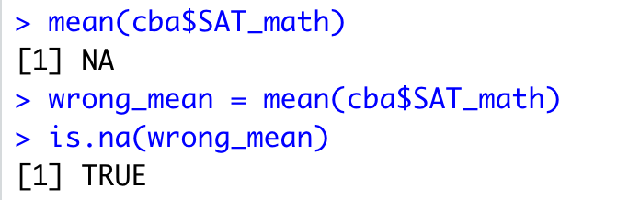
Topic: is.na() and factors
First load in cba_admissions_1999.txt dataset containing admissions profiles for cba students from 1999. It can be found in the file folder for Assignment 4 or on the Assignment 4 canvas page.
Try running the following lines
NA is a special type in R. It represents missing values and can be very annoying! Will mess up your functions if your data has them.

Slide 4
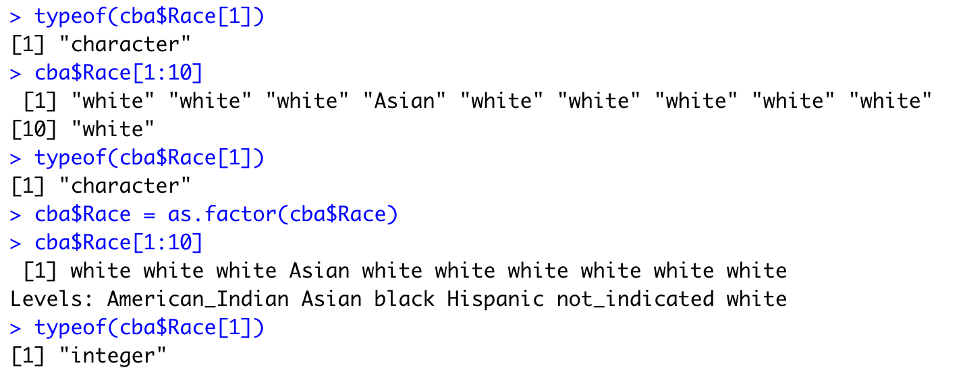
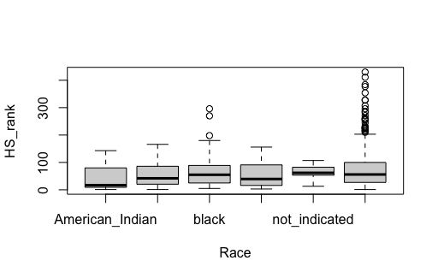
Topic: is.na() and factors
Factors are how R understands categorical data. It is distinct from characters or numerics. We use the command as.factor() to create factored data.
Example:
plot(data = cba, HS_rank ~ Race)
Note: requires factored

Slide 5
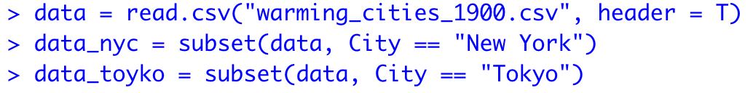
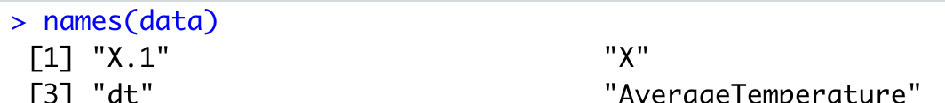
Data for this lecture
Download the file: warming_cities_1990.csv located in the Lecture 6 Folder
This is the average monthly temperature of six cities: "Bangalore”, "Cape Town”, "London", "Los Angeles”, "New York”, and "Tokyo” from 1900-2013
To see columns run:

Slide 6
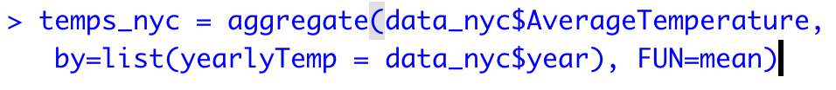
Topic: The function aggregate()
Often, we would like to aggregate data in specific ways. In R this is easily accomplished via the aggregate() function. The syntax is:
Aggregate(data_to_aggregate, by = list(name = labels), FUN = func_to_apply)
Example: Suppose we want to the average temperature in NYC for each year (in the data each row represents a month!):
Data being collapsed by year
Vector of group labels to collapse by
The mean() function is run on each group.

Slide 7
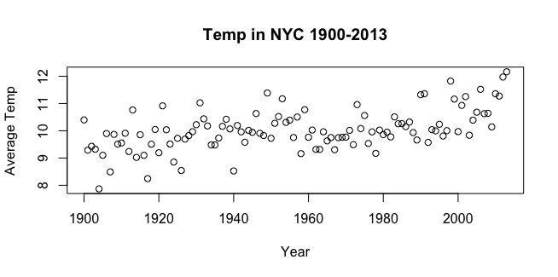
Topic: Plotting numeric data
We plot a vector of y data by a vector of x data using the syntax plot(y ~ x) or by plot(x,y)
Example:

Slide 8
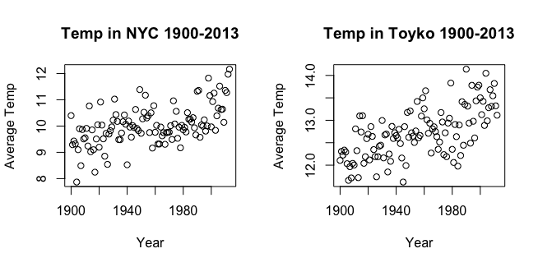
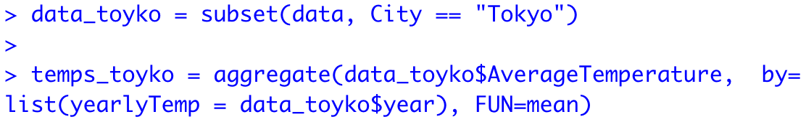
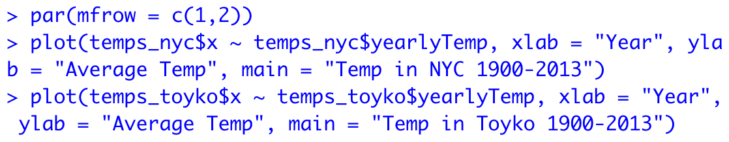
Topic: Plotting numeric data side by side
We can make multiple plots in a grid using the par() function.
Syntax: par(mfrow = c(num_rows, num_cols))
The par function tells R to lay out a grid for plots, then populates in one at a time
Example:

Slide 9
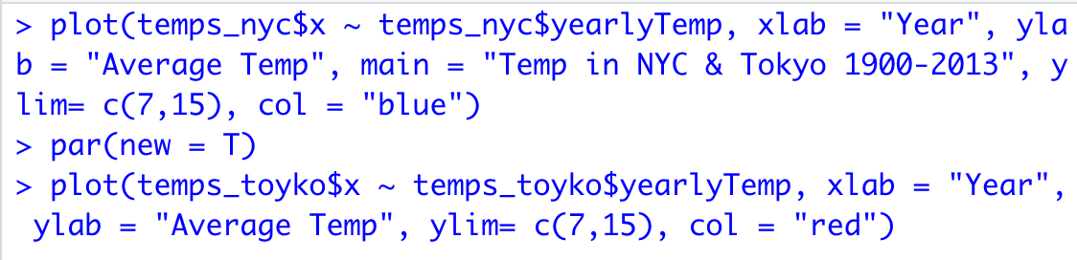
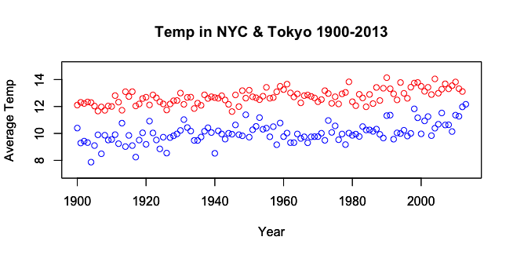
Topic: Plotting numeric data on one graph
We can make layer this plots using the par() function as well.
Syntax: par(new = TRUE) between plot() calls!
The par tells R to add on the next plot
Example:
Note the ylim parameter! This tells R what the y limits should be! Important since they’ll be on the same plot!
Note in the second command I omitted the call to main. No new title needed!

Slide 10
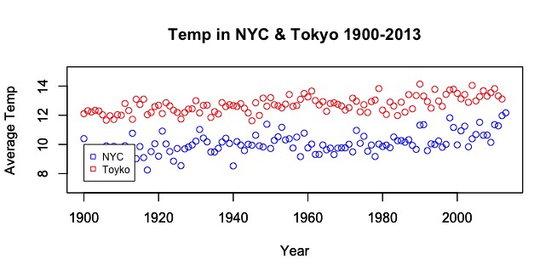
Topic: Plotting numeric data on one graph
We can also add a legend using the legend() function afterwards!
Syntax: (After plots) legend(x_loc, y_loc, legend=vec_names, col = vec_cols, cex = size_scaler, pch = vec_markers)
The par() tells R to add on the next plot
Example:
The legend is placed at x and y coordinates. Information is passed as vectors!

Slide 11
For Next Time
Assignment 4 is posted! It’s about plotting due (9/18)
Assignment 3 is due on Friday (9/11)
Thanks! See you on Tuesday!

